Slide 1
Distributed Systems Architectures

Slide 2
Distributed Systems Architectures
As distributed systems are composed of multiple machines it is important to organise them into an architecture
  Without organisation the implementation of such a system becomes complex
  Note that there is both a physical and logical organisation of the system
    The logical architecture may not follow that of the physical architecture

Slide 3
System and Software Architectures
Software architectures describes the various software components should be organised
  Also details the interactions
System architectures detail where the software components should be placed on physical machines and the physical links between nodes

Slide 4
Architectural Style
An architectural style details the components, their connections to each other, the data exchanged between them, and how the components are configured into a single system
  A component is a modular unit with well defined interfaces
  A connector is a mechanism for mediating communications between components
  By combining the two we have the four main architectures: Layered, Object-based, Data-centred, and Event-based

Slide 5
Layered Architecture
In this style components are organised into layers, a component at L_{i} can call components at L_{(i-1)} but not to L_{(i+1)}
  An architecture that has been adopted by most networking and OS systems
Generally requests will flow down from the top layer
While results will flow up from the bottom layers

Slide 6
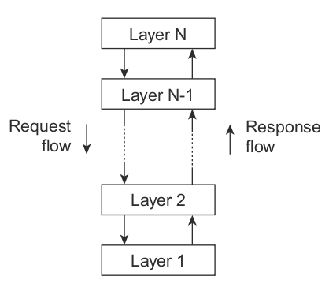
Layered Architecture

Slide 7
Object Based Architecture
A much looser organisation of components is the object based architecture
  Where each component is defined by object and the connections are some form of remote procedure call (RPC)
  Similar in style to client server architectures
  Supposed to extend the object oriented model into the distributed systems world

Slide 8
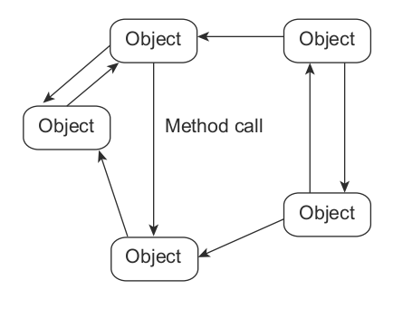
Object Based Architecture

Slide 9
Data Centred Architecture
A data centred architecture is one where processes communicate through a common data repository.
  Examples of this include applications that share information through distributed file systems (Hadoop, Map-Reduce etc.)

Slide 10
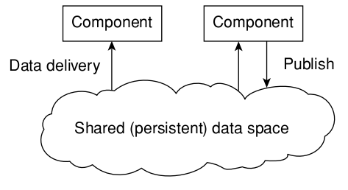
Data Cantered Architecture

Slide 11
Event Based Architecture
Event based architectures communicate through events that may or may not have data attached
  Examples of these would include publish/subscribe systems
  One or more process publish events
  Other processes subscribed to those events receive them and react to them

Slide 12
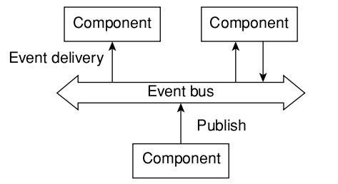
Event Based Architecture

Slide 13
Centralised Architecture
A centralised (client/server) system architecture helps manage the complexity of a distributed system
  Components are divided into groups (that may overlap) of clients and servers.
  A server will implement a service
  A client will request a service from a server
  This implements request-reply behaviour

Slide 14
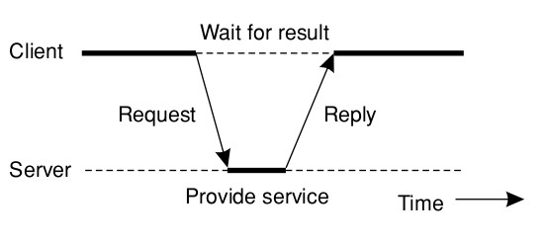
Centralised Architecture

Slide 15
Multitiered Architecture
A multi-tiered architecture is one in which there are two or more layers and processing is distributed amongst those layers
Most general case is a client rendering a UI and a server doing processing and data handling tasks.
  The workload may be distributed amongst the tiers to alleviate saturation of the server components where possible
Need to provide balance as too much processing on the client does not work well

Slide 16
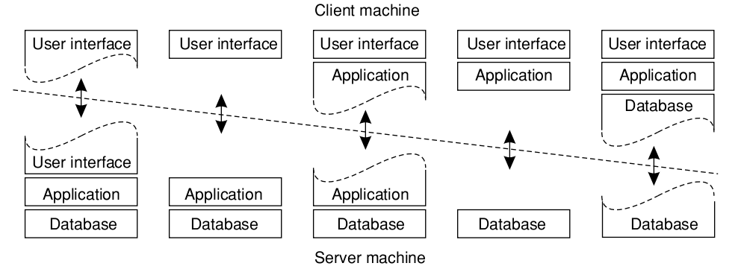
Multitiered Architecture

Slide 17
Multitiered Architecture
A website is a good example of multi-tiered architecture.
  Where the client renders a UI but makes requests to the webserver
  The webserver will do some processing but may also be a client and make a request to a database
  Before results are then passed back to the server for final processing and passing to the client

Slide 18
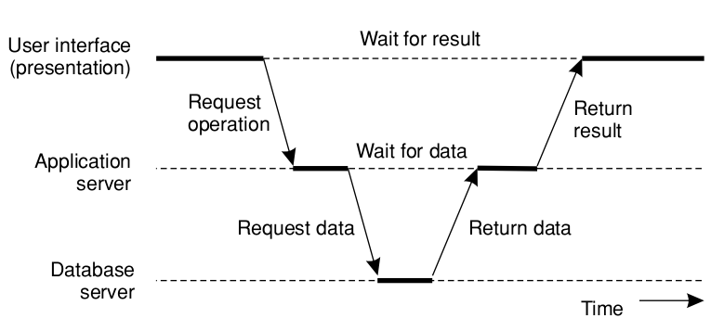
Multitiered Architecture

Slide 19
Decentralised Architectures
Centralised multitier architectures use vertical distribution where components are separated into different layers
But it is also possible to split up servers and clients into many different parts and distribute processing that way
  To get horizontal distribution.
  However if we go a step further and make every node both a client and a server we end up with a decentralised or peer-to-peer system

Slide 20
Overlay Network
Thus the main question is: how to organise nodes in a P2P system?
Will be in the form of an overlay network. Which is a network in which the nodes are formed by the processes and the links representing the possible communication channels
  Two processes cannot communicate directly
  Must send messages along their communication channels

Slide 21
Structured Peer to Peer networks
Structured P2P networks construct an overlay network using a deterministic procedure for example a distributed hash table (DHT)
  Every item is assigned a random ID from a 128bit space or higher. (very unlikely to generate same IDs)
  The DHT then must implement an efficient and deterministic method to uniquely map the key of the item to the identifier of the node based on a distance metric
  When looking up the data item the network address of the node containing that item should be returned.

Slide 22
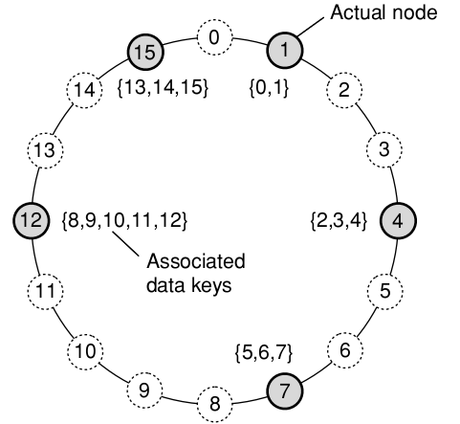
Structured Peer to Peer networks

Slide 23
Structured Peer to Peer networks
Nodes are required to organise themselves into this overlay network through a process of membership management
  Each node will maintain links to other nodes in the system such that lookups are done in log n time.
  When a node wishes to join in the network it generates an id and performs a lookup on that id which returns it the successor node
  It links to that node and inserts itself into the table and links to its predecessor node too.

Slide 24
Unstructured Peer to Peer networks
Unstructured Peer to Peer networks use randomised algorithms for generating the overlay network.
  Each node maintains a list of neighbours
  Each node will have a different set of neighbours (larger or smaller set) depending on network
  Highly variant on each join into the network.

Slide 25
Unstructured Peer to Peer networks
The goal of each node in an unstructured network is to generate an overlay that looks similar to a random graph.
  All nodes maintain a list of c neighbours
  Each node represents a randomly chosen live node.
  Impossible to get exact same list on each join

Slide 26
Unstructured Peer to Peer networks
Searching for items in an unstructured network may take more time as the size of the network grows as there is no method to deterministically look up the address of a node
  The only possibility is to flood the network with a search request
  To alleviate this issue some networks use nodes whose sole purpose is to maintain an index of data items. We call these super peers.
  Thus requests are routed between super peers to reduce flooding of the network

Slide 27
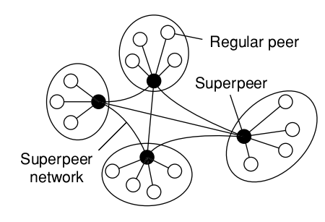
Unstructured Peer to Peer networks

Slide 28
Hybrid Architectures
So far we have exclusively focused on either centralised or decentralised systems.
  However, some distributed systems will combine features of both centralised and decentralised systems
  We call these hybrid systems.

Slide 29
Hybrid Architectures
An Edge-server system is an example of a hybrid architecture. An example of this is the ISP network.
  ISPs form the edge between public and private networks.
  The nodes in the private network are clients of the edge server
  While the ISPs themselves provide translation between the private and public network

Slide 30
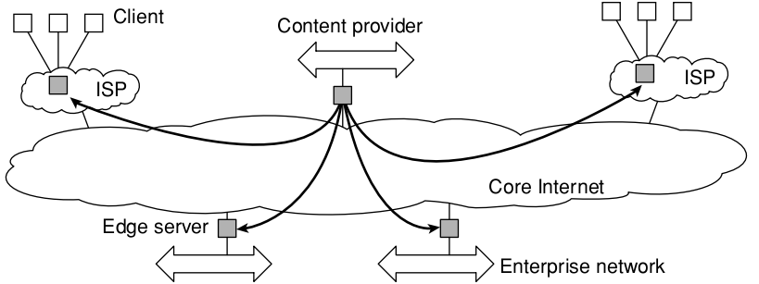
Hybrid Architectures

Slide 31
Hybrid Architectures
Collaborative Distributed systems are another place where hybrid structures are used. The difficultly here is getting the network initialised
  Takes place through a normal client server architecture.
  Then the peer to peer network is then formed after the client gets a list of nodes to connect to on the network
  Bit torrent is an example of such a system

Slide 32
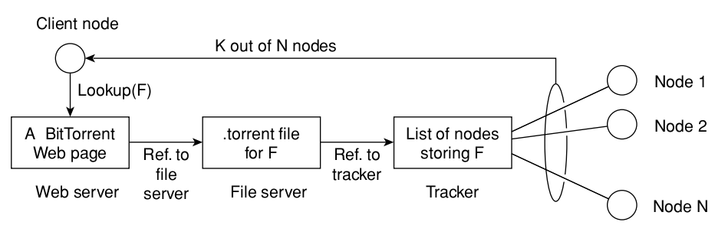
Hybrid Architectures

Slide 33
Architectures Vs Middleware

Slide 34
Architectures Vs Middleware
When considering the architectures, where does middleware fit in?
  Middleware should provide distribution transparency. However, in practice middleware will implement its own architectural style.
  If your application follows that style then programming on that middleware becomes simpler.
  However, this restricts the architectural styles available for your application, putting another style on top may reduce performance.

Slide 35
Interceptors
An interceptor is a software construct that will break the flow of control and permit other code to execute.
  The idea is that an object A should be able to call a method that belongs to object B, while B is on a different node to A
  When a call is presented to the application stub it will be intercepted by a request level interceptor. If there are multiple replicas of the object available it will redirect to one of the replicas
  Objects and calls may need to be transferred over the network. This is where a message level interceptor will be needed to disassemble and send messages across the network and vice versa

Slide 36
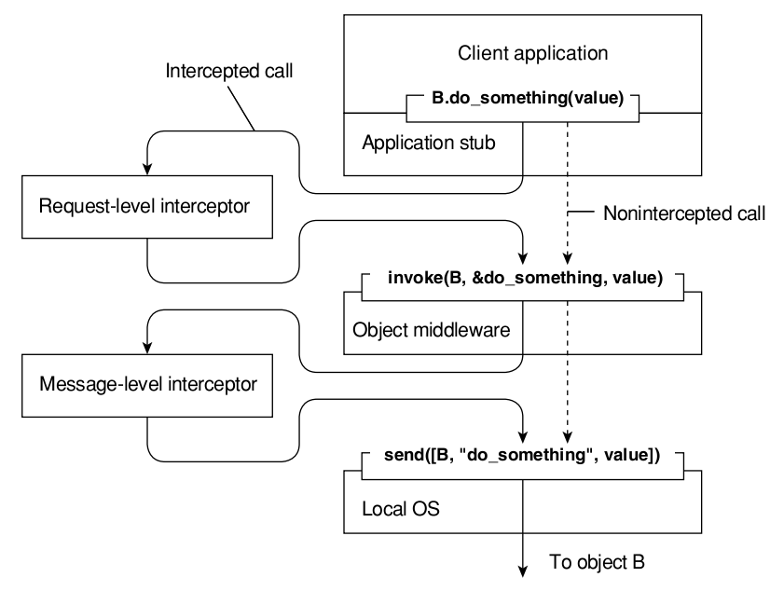
Interceptors

Slide 37
Adaptive Software
What interceptors offer is middleware adaption. As the distributed environment can change continuously.
  Rather than make the application respond to changes the middleware should respond to these changes.
  Adaptive software has not been successful thus far as it is still a research area
  For adaptive software to work it must implement three techniques for the software to adapt

Slide 38
Adaptive Software
Separation of concerns: separate those parts implementing functionality from those that take care of reliability security etc.
Computational reflection: allows the program to inspect itself and if necessary adapt itself (has been implemented in programming languages)
Component based design: uses composition to build the system either statically at compile time, or dynamically at run time through the use of late binding.

Slide 39
Self Management
As distributed systems increase in size and complexity, managing them becomes more difficult.
  Autonomic systems: a class of distributed systems that have feedback systems, permitting them to self control and adapt to changes.
  i.e. self-managing, self-healing, self-configuring etc.

Slide 40
Self Management
The implementation of one or more feedback control loops is common to all autonomic systems.
  Every component that needs to be managed has controllable input parameters. But there are uncontrollable parameters that may influence behaviour too.
  The system will also implement some form of monitoring but for large systems, full measurements are difficult so metric estimation components may be used instead.
  Finally there is an analysis component that will generate new inputs based on a reference and all the measurements that have come in.

Slide 41
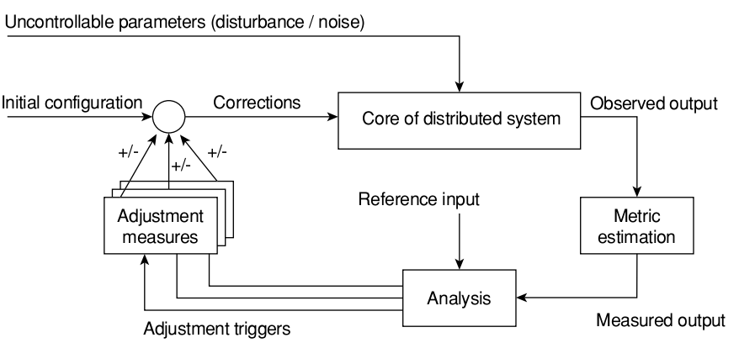
Self Management (EOL)

